Slide 1
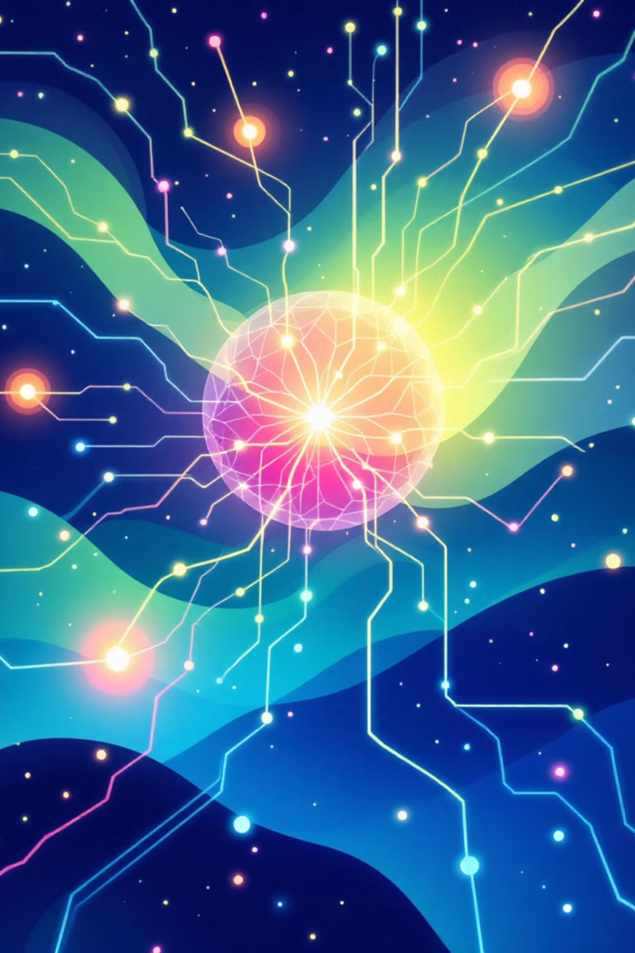


What is Artificial Intelligence?
Understanding AI: The Science of Intelligent Machines
By
Bh. Sai Ganesh
Assistant Professor
Aditya University

Slide 2


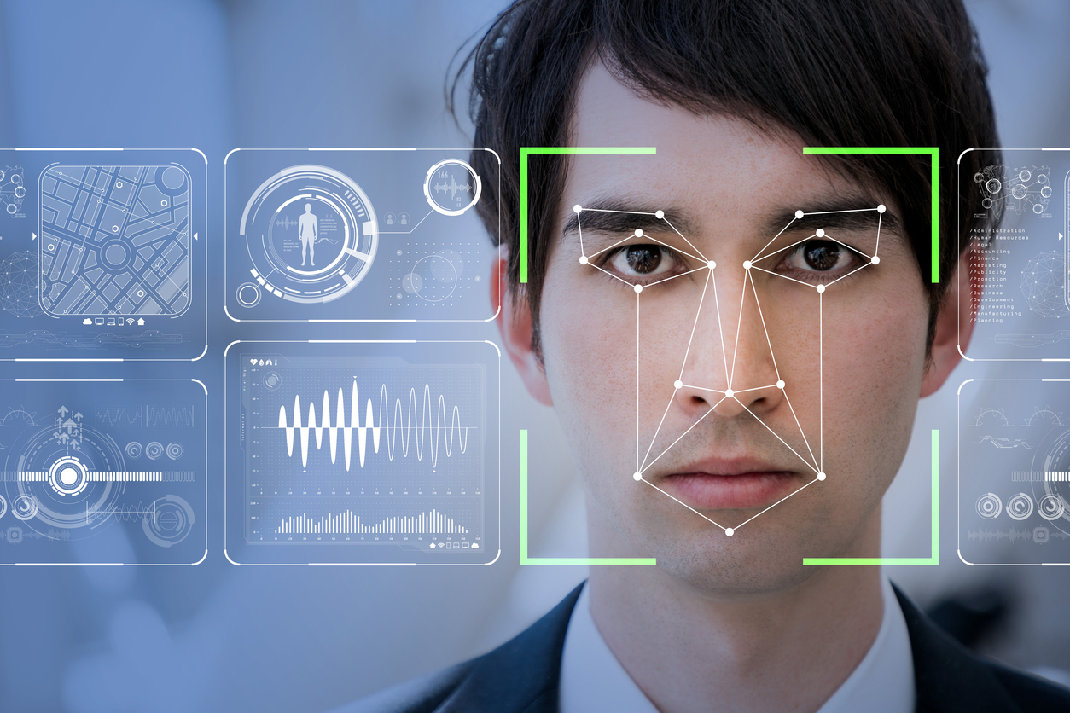

Defining AI: Beyond Human-Like Thinking
AI, is the branch of computer science focused on creating machines that can perform tasks requiring human-like intelligence. This includes things like understanding natural language, recognizing images, making decisions, or learning from experience. Essentially, it's about giving computers the ability to mimic certain forms of human intelligence.
Examples:
Understanding language (like ChatGPT,Siri)
Recognizing images or faces (like in smartphones)

Slide 3
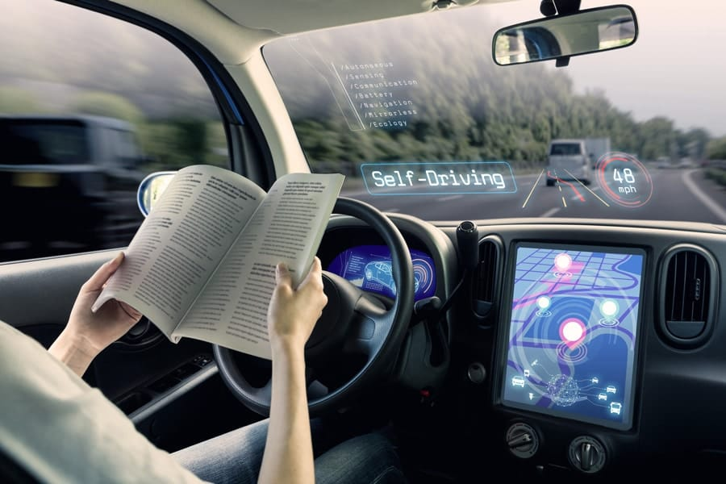

Making decisions (like self-driving cars)
Learning from experience (like recommendation systems on YouTube or Netflix)

Slide 4
Examples of AI in real life :
Example | How AI Works
Google Maps | Predicts traffic and suggests fastest routes
Siri/Alexa/Google Assistant | Understands speech and responds
ChatGPT | Understands text and generates answers
Online shopping ads | Learns from user behavior and recommends products
Banking fraud detection | Detects unusual transactions

Slide 5

Four Core Approaches to AI
Thinking Humanly
Thinking Rationally
Cognitive modelling of how the human brain solves problems and processes information
Logic and laws of thought to reason correctly and derive conclusions
Acting Humanly
Acting Rationally
Passing the Turing Test — behaviour indistinguishable from human responses
Rational agents that act to achieve the best expected outcome

Slide 6







Foundations of AI: A Multidisciplinary
Endeavour
Philosophy
Mathematics
Reasoning, problem-solving, symbolic AI
Formal models, algorithms, and computational theory
Neuroscience & Psychology
Computer Engineering
Understanding human cognition and brain function
Building machines and computational systems
Linguistics
Economics & Control Theory
Enabling language understanding and processing
Decision-making and system optimisation

Slide 7
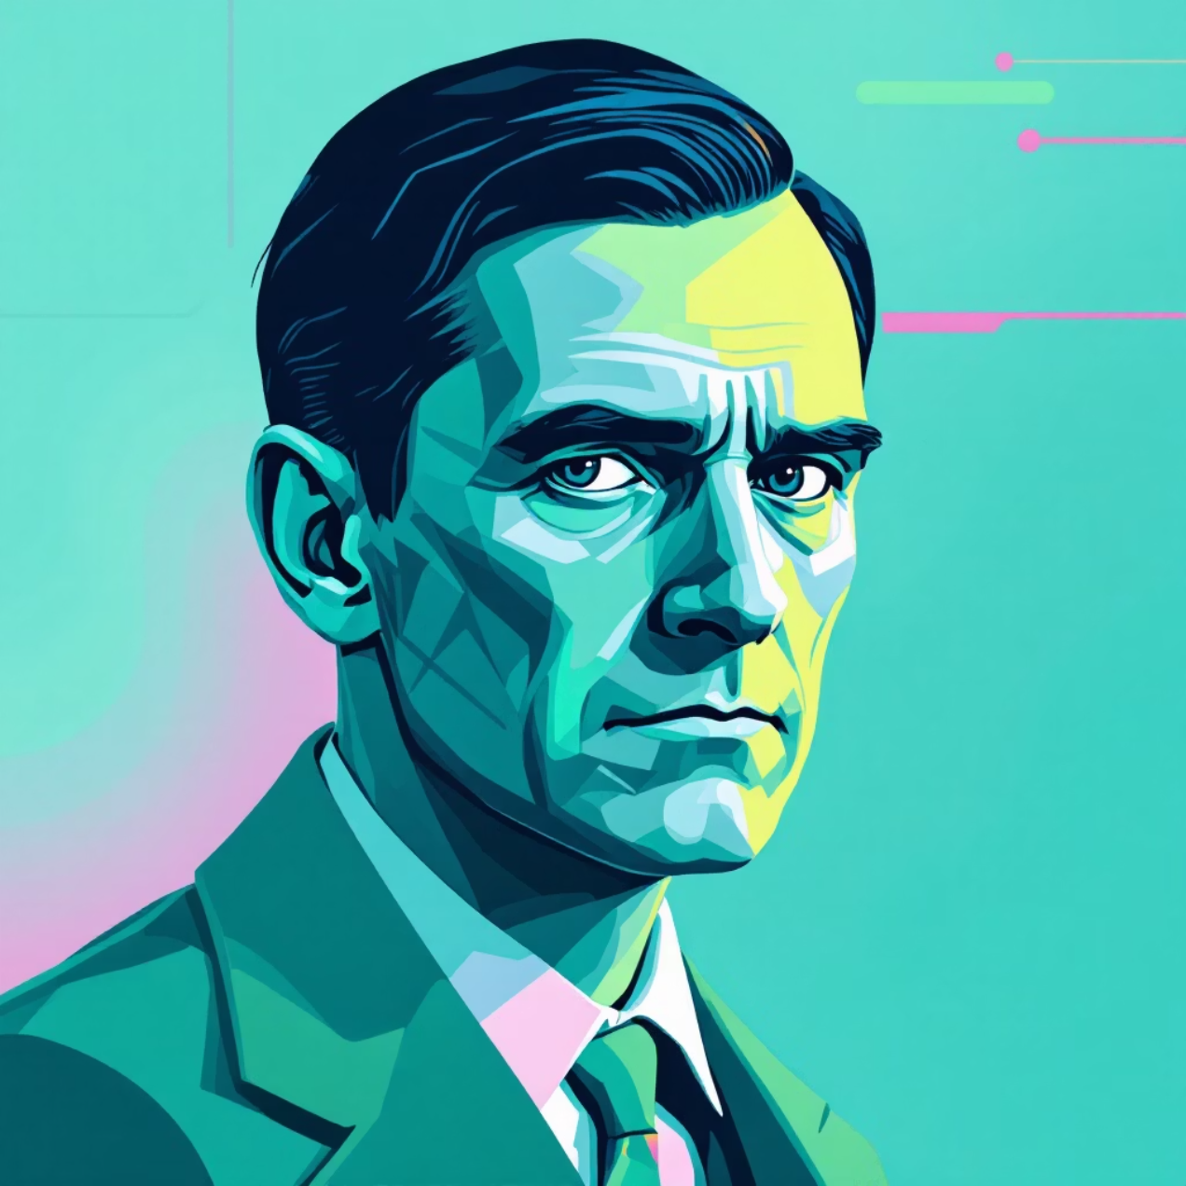

The Dawn of AI: Alan Turing's Vision
1936
1
Turing's "Universal Machine" concept laid groundwork for programmable computers
2
1950
Turing's seminal paper proposed the "Imitation Game" (Turing Test) to assess machine intelligence
Turing imagined machines that could learn and improve beyond their initial programming — a vision that continues to inspire AI research today.

Slide 8


The Birth of AI as a Field
Dartmouth Conference, 1956
Bringing Pioneers Together
John McCarthy coined the term "Artificial Intelligence" at this pivotal summer workshop.
The conference united visionaries to explore "thinking machines" and their potential.
A New Scientific Discipline
Set the foundation for AI research as a formal field of scientific inquiry.

Slide 9
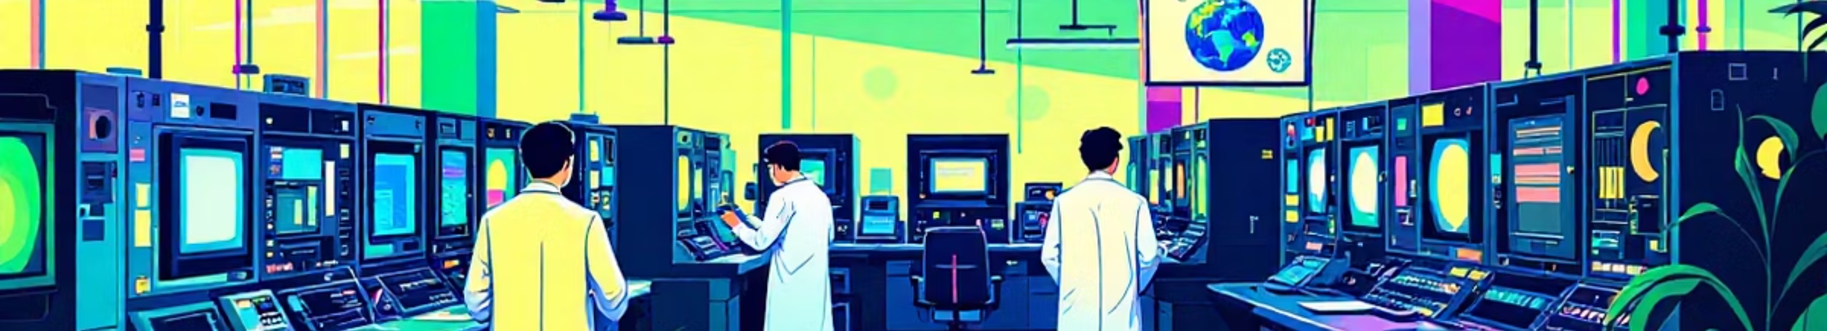




Early Milestones: 1950s to 1970s
1970s: Expert Systems
1966: ELIZA
Development of rule-based expert systems and early robotics applications in manufacturing and medicine.
1956: Logic Theorist
Joseph Weizenbaum developed the first chatbot, simulating human conversation and natural language processing.
Allen Newell and Herbert Simon created the first AI programme, proving mathematical theorems and demonstrating machine reasoning.

Slide 10
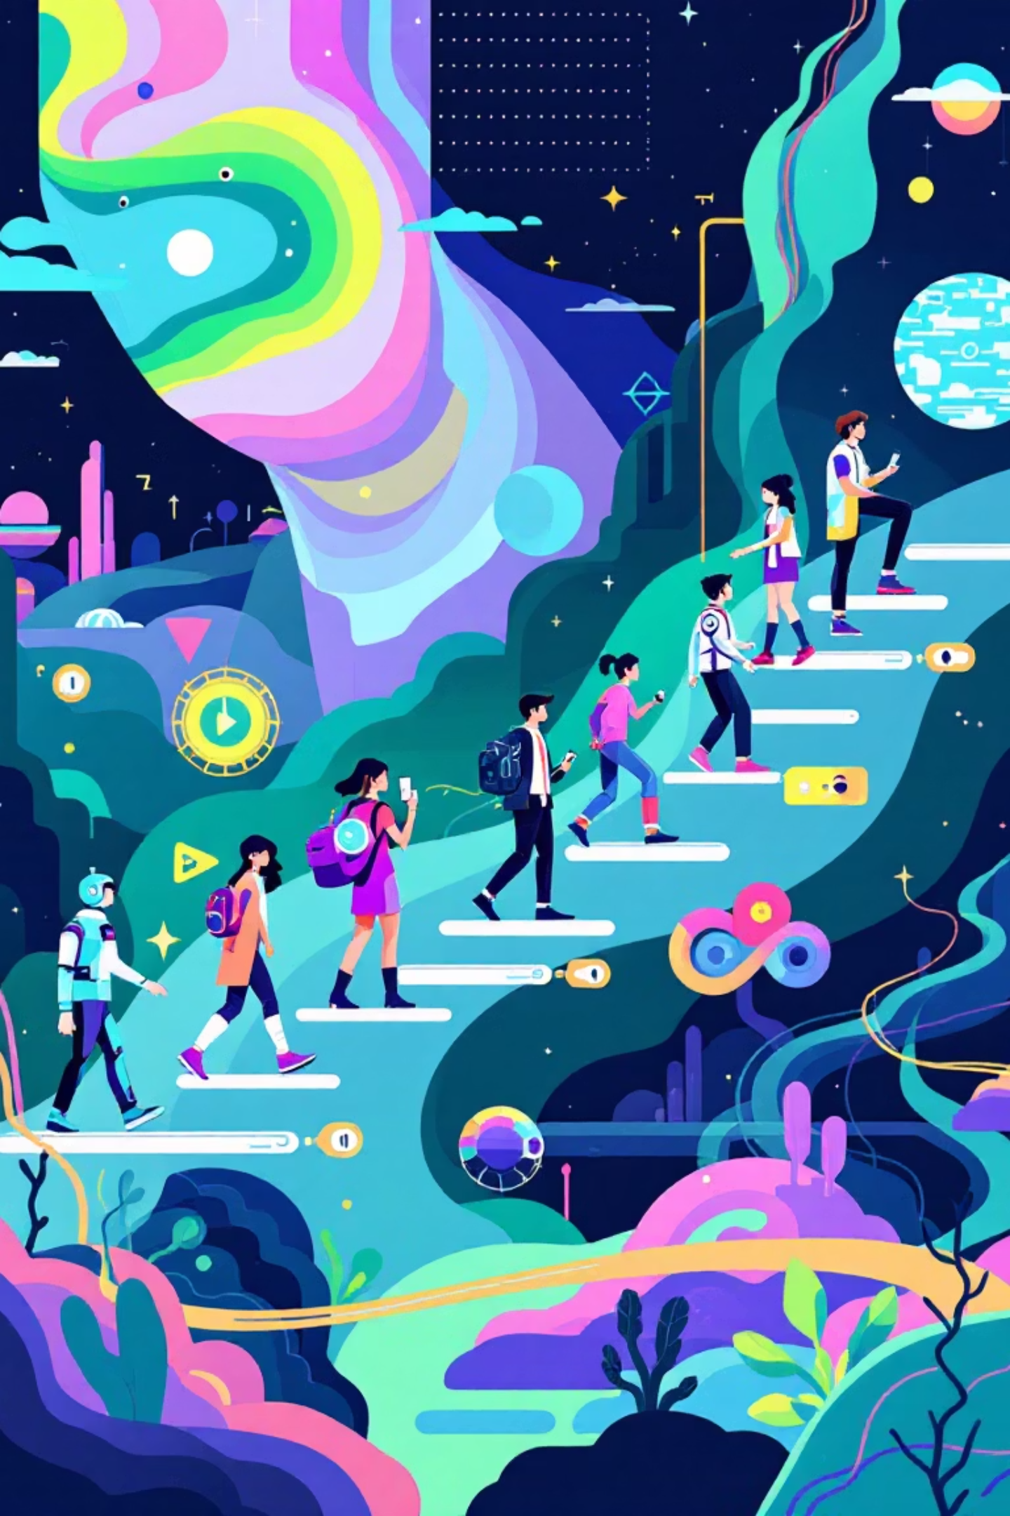


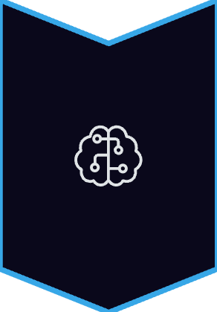
AI's Evolution: From Symbolic AI to Machine Learning
Symbolic AI Era(1956–1974)
Early AI focused on symbolic reasoning and logic (Good Old-Fashioned AI)
LISP programming language
Machine Learning (1974-1980)
Shift towards learning from data: Machine Learning emerged as a powerful subfield
Deep Learning
Neural networks revolutionised AI in the 2010s with breakthroughs in vision and language

Slide 11
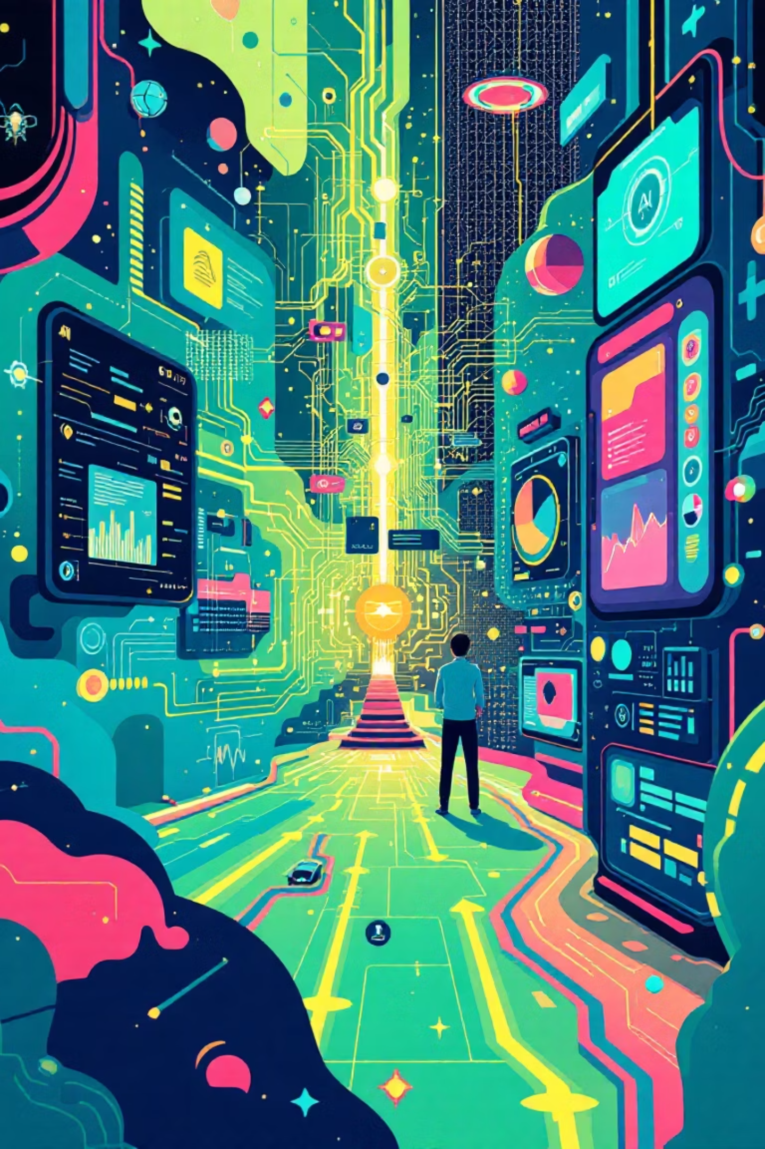




AI Today and Tomorrow
Everyday Applications
AI powers voice assistants, autonomous vehicles, and medical diagnosis systems that improve daily life.
Generative AI
Foundation models enable creative tasks: generating text, images, video, and music with unprecedented quality.
Ethical Challenges
Societal impacts, bias, privacy, and responsible development are central to ongoing AI advancement.

Slide 12
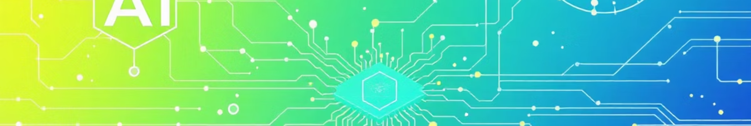


The Journey Continues
From Theory to Reality
Reshaping Our World
Navigating the Future
From Turing's theoretical ideas to today's transformative technologies
AI is transforming industries, science, and daily life in profound ways
Understanding AI's foundations and history helps us shape its future responsibly
Thank you!

